Slide 1
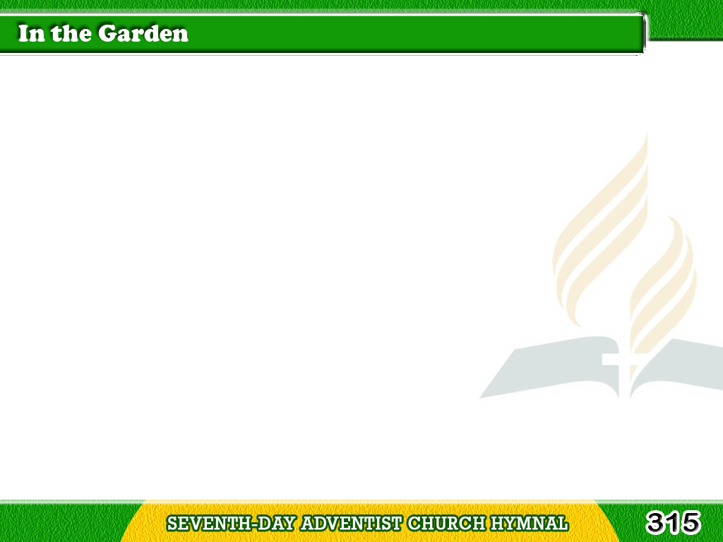
1/3
I come to the garden alone,
While the dew is still
on the roses;
Tagalog
Version

Slide 2
1/3
And the voice I hear,
falling on my ear,
The Son of God discloses.
Tagalog
Version

Slide 3
1/3
Chorus
And He walks with me,
and He talks with me,
And He tells me I am His own;
Tagalog
Version

Slide 4
1/3
Chorus
And the joy we share
as we tarry there,
None other has ever known.
Tagalog
Version

Slide 5
2/3
He speaks, and the sound
of His voice
Is so sweet the birds hush
their singing,
Tagalog
Version

Slide 6
2/3
And the melody
that He gave to me
Within my heart is ringing.
Tagalog
Version

Slide 7
2/3
Chorus
And He walks with me,
and He talks with me,
And He tells me I am His own;
Tagalog
Version

Slide 8
2/3
Chorus
And the joy we share
as we tarry there,
None other has ever known.
Tagalog
Version

Slide 9
3/3
I’d stay in the garden with Him
Though the night
around me be falling,
Tagalog
Version

Slide 10
3/3
But He bids me go;
through the voice of woe,
His voice to me is calling.
Tagalog
Version

Slide 11
3/3
Chorus
And He walks with me,
and He talks with me,
And He tells me I am His own;
Tagalog
Version

Slide 12
3/3
Chorus
And the joy we share
as we tarry there,
None other has ever known.
Tagalog
Version

